Slide 1


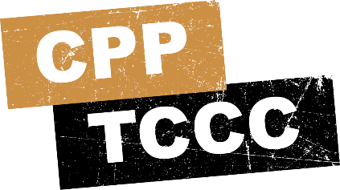


TACTICAL COMBAT CASUALTY CARE COURSE
MODULE 17: WOUND MANAGEMENT
Module 17: Wound Management
#TCCC-CPP-PPT-17 08 AUG 23
COMBAT PARAMEDIC/ PROVIDER
TCCC TIER 1
All Service Members
TCCC TIER 2
Combat Lifesaver
TCCC TIER 3
Combat Medic/Corpsman
TCCC TIER 4
Combat Paramedic/Provider

Slide 2


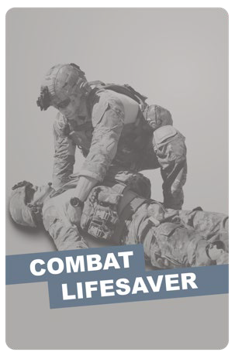
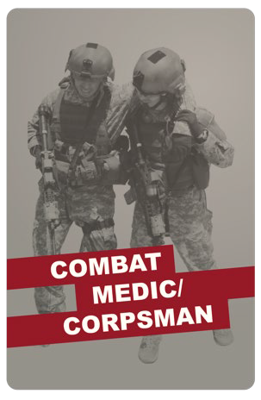

Module 17: Wound Management
TACTICAL COMBAT CASUALTY CARE (TCCC) ROLE-BASED TRAINING SPECTRUM
ROLE 1 CARE
NONMEDICAL PERSONNEL
MEDICAL PERSONNEL
YOU ARE HERE
STANDARDIZED JOINT CURRICULUM
Notes:
This module discusses wound management in the Tactical Field Care (TFC) setting, highlighting actions you should take as a Combat Paramedic or Provider (CPP).
All Service Member and Combat Lifesaver training trains non-medical personnel about basic wound management and Combat Medics are trained in the additional wound management procedures you will be learning. As a Combat Paramedic/Provider, you not only need to know that information and master those skills, you should also understand how guidelines were developed and be able to answer questions about wound management in a TFC environment.

Slide 3
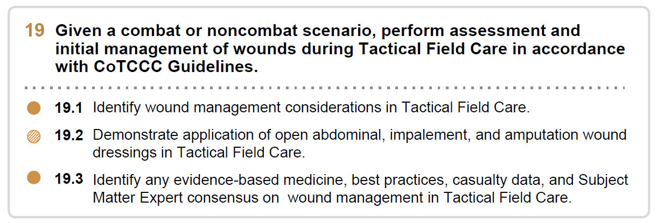







Module 17: Wound Management
1 x TERMINAL LEARNING OBJECTIVES
Given a combat or noncombat scenario, perform assessment and initial management of wounds during Tactical Field Care in accordance with CoTCCC Guidelines.
  Identify wound management considerations in Tactical Field Care.
  Demonstrate application of open abdominal, impalement, and amputation wound dressings in Tactical Field Care.
  Identify any evidence-based medicine, best practices, casualty data, and Subject Matter Expert consensus on wound management in Tactical Field Care.
03 x ENABLING LEARNING OBJECTIVES
#
= Terminal Learning Objectives
= Cognitive ELOs
= Performance ELOs
Notes:
There are two cognitive and one performance-enabling learning objectives in this module.
After this module, you should be able to identify wound management considerations in Tactical Field Care. This will include general wound management principles, open abdominal wounds, impaled objects, and dressing amputations. You should also understand the evidence for the strategies behind wound management in the TFC setting will be covered.
Also, you will demonstrate the application of open abdominal, impalement, and amputation wound dressings in the skills station.
In general, this means recognizing non-life-threatening wounds, knowing the steps to treat them and when in the treatment sequence they should be addressed, being able to demonstrate how to apply wound dressings to those injuries, and being able to answer questions about the guidelines and evidence that led to their development.

Slide 4
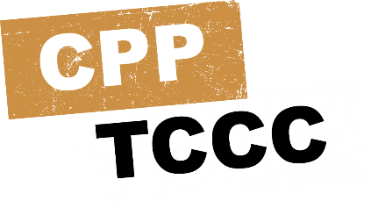
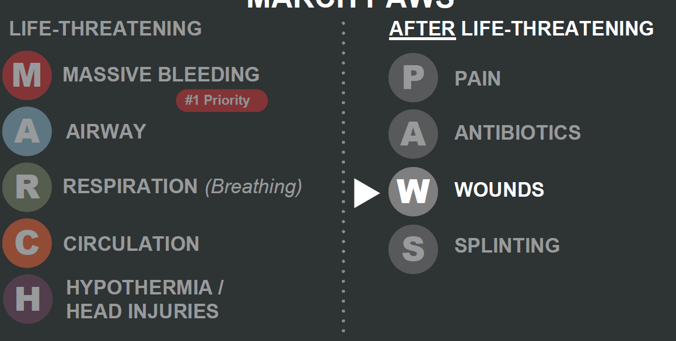
MARCH PAWS
Module 17: Wound Management
LIFE-THREATENING
AFTER LIFE-THREATENING
PAIN ANTIBIOTICS
WOUNDS SPLINTING
M A R C H
P A
MASSIVE BLEEDING
#1 Priority
AIRWAY
RESPIRATION (Breathing)
W
CIRCULATION
S
HYPOTHERMIA / HEAD INJURIES
Notes:
Wound management is the “W” in the MARCH PAWS sequence

Slide 5


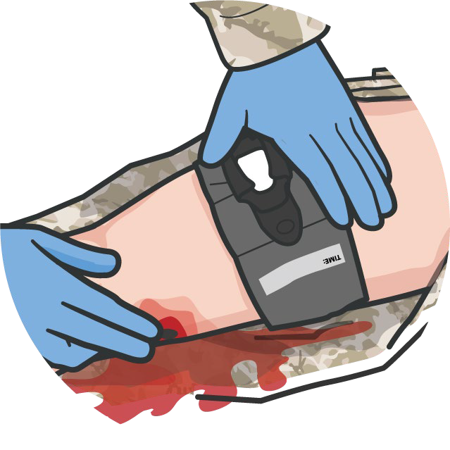
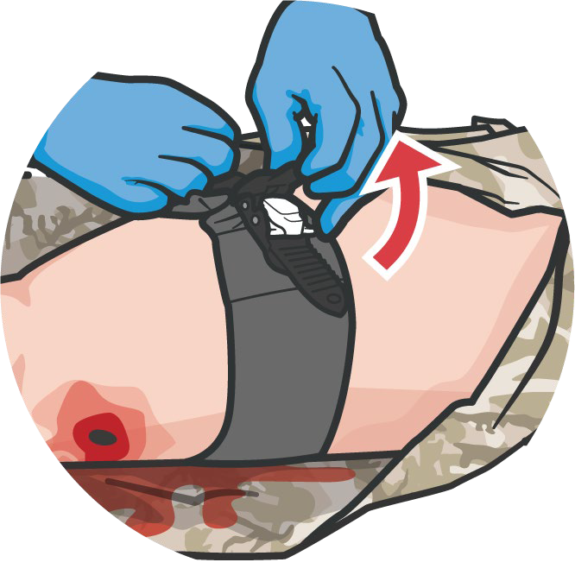

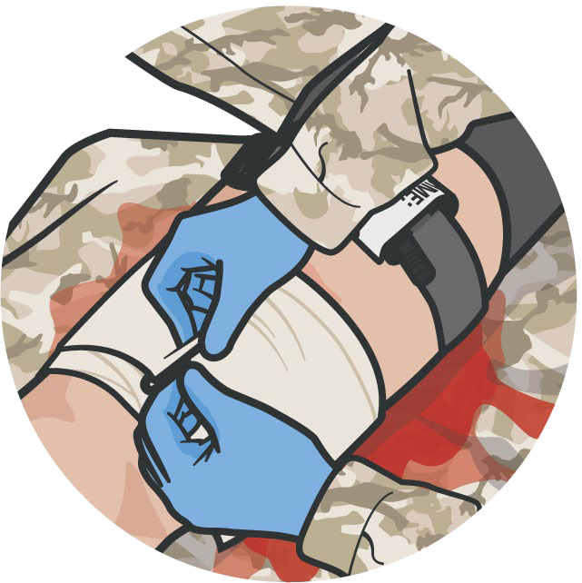

GENERAL WOUND MANAGEMENT PRINCIPLES
Module 17: Wound Management
REASSESS prior life- threatening wounds to ensure bleeding is still controlled
Only after reassessing all previously addressed
wounds should you address non-life-threatening or minor wounds
If bleeding has NOT been controlled:
Tighten or add additional tourniquets
Add packing or tighten pressure bandages
Redress the wounds
Address any unsealed open chest wounds
Shield any exposed eye injuries
REMEMBER:
NEVER apply a tourniquet and forget it!
P A W S
Notes:
The TCCC Wound Management Guidelines state “inspect and dress known wounds” and later “check for additional wounds,” with more a comprehensive discussion of open abdominal wounds.¹
But prior to addressing new non-life-threatening wounds, it is important to reassess any wounds that have previously been addressed to ensure prior interventions were successful and the casualty’s status hasn’t changed.² This frequent reassessment should be an ongoing process, and not restricted to a specific step in the casualty management process. Do not forget to reassess any intervention you have performed.
For bleeding, this means rechecking any tourniquets to confirm hemorrhage control and absent distal pulses, if appropriate. Wound packings, pressure dressings, and junctional tourniquets should be reassessed to ensure there isn’t evidence of ongoing bleeding.
Options to consider if there are any signs of recurrent or persistent bleeding include:
Retightening tourniquets or adding additional tourniquets³
Adding additional packing or pressure dressings
Repacking and applying new pressure dressings
Shielding any eye injuries that are still exposed/unshielded⁴
Addressing any open chest wounds that are not properly sealed⁵
Any interventions that are repeated should follow the same process that is appropriate for a newly found life-threatening wound.
Only after reassessing all previously addressed wounds and confirming that a life-threatening wound hasn’t been missed, and treating any of those that warrant treatment, should you go on to address non-life-threatening, or minor wounds.

Slide 6

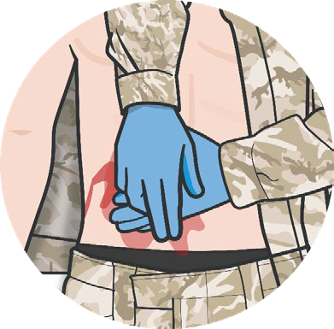


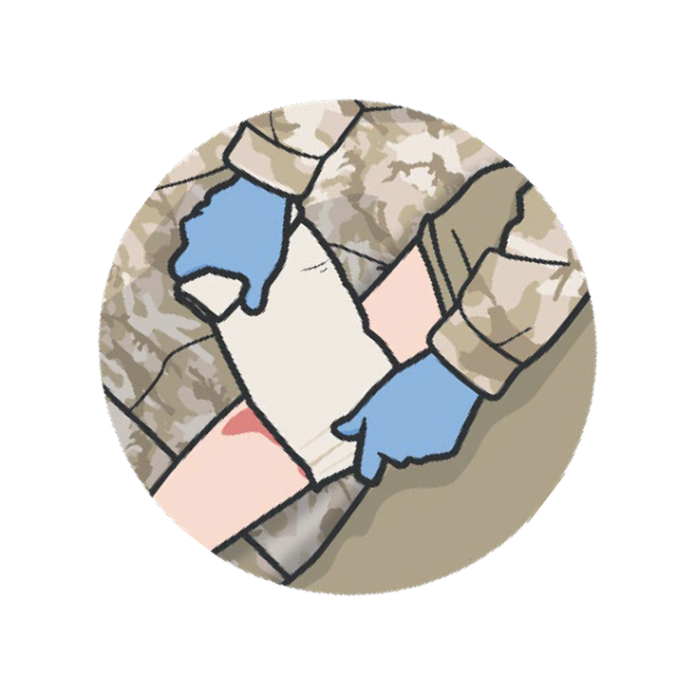

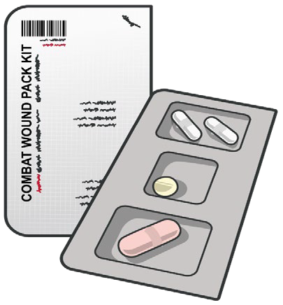

Module 17: Wound Management
GENERAL WOUND MANAGEMENT PRINCIPLES (CONT.)
Non-life-threatening wounds include: Lacerations without massive bleeding Abrasions
Open abdominal wounds Impaled objects Amputation stumps
Delayed considerations:
Need for debridement, tetanus boosters and maintenance (or changes) in antibiotics
General Wound Management Principles:
APPLY direct pressure, as needed (hemostatic dressings not indicated with minor bleeding)
IRRIGATE & CLEAN wounds with sterile or clean water
DRESS wounds with gauze and bandages or dry, clean cloths
ADMINISTER Antibiotics
P A
W
S
Level of Evidence: C-LD
Notes:
Once you have reassessed any prior treatments, other wounds should be addressed. In a bit, we’ll talk about three specific wounds – open abdominal wounds, impaled objects, and amputations, but there are some general wound management considerations that apply to these and all other minor or non-life-threatening wounds. Examples of these are minor lacerations or abrasions.⁶
It may be necessary to apply direct pressure for a period of time to help a minor wound stop bleeding, but hemostatic dressings are not normally indicated in this setting.
Next, irrigate and clean wounds with either sterile water, if it is available, or even clean water if your supplies are limited or you have no access to sterile water.⁷ The goal is to clean the wound and remove obvious foreign debris, but not to sterilize it; so, the irrigation should be thorough, but not excessive.
Once irrigated, wounds can be dressed. If supplies are available and not needed for more serious wounds or other casualties, you can apply sterile dressings and/or gauze with bandages or tape. But it may also be necessary to conserve those supplies, and clean dry cloths may be used, and either tied in place or secured with tape. Conserve your hemostatic agents and pressure bandages for sources of more serious hemorrhage.
As highlighted in module 16, all open wounds warrant early antibiotic administration.⁸ If the casualty can swallow, have them take the moxifloxacin from their Combat Wound Medication Pack. If they cannot take PO meds, are unconscious, or in shock, they should be given one gram of ertapenem by intramuscular, intravenous, or intraosseous injection or infusion.
If the casualty is evacuated to a higher level of care, the wounds will be readdressed at that point, and decisions about the need for debridement, tetanus immunization boosters, and maintenance (or changes) in antibiotics will be made. If the casualty can return to the fight, you will need to address those concerns over the next several days as you see the casualty again for the reassessment of their wounds.
The level of evidence supporting the guidance for general wound management is based on a meta-analysis of observational studies, lab evaluations, and case studies.

Slide 7



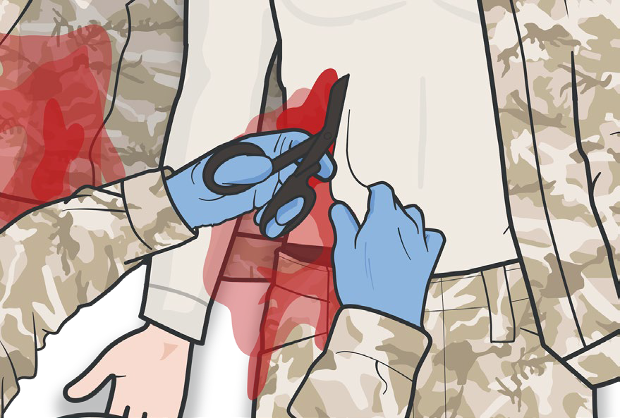
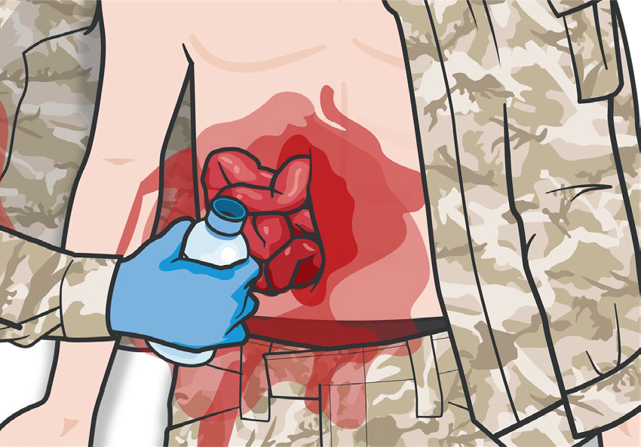
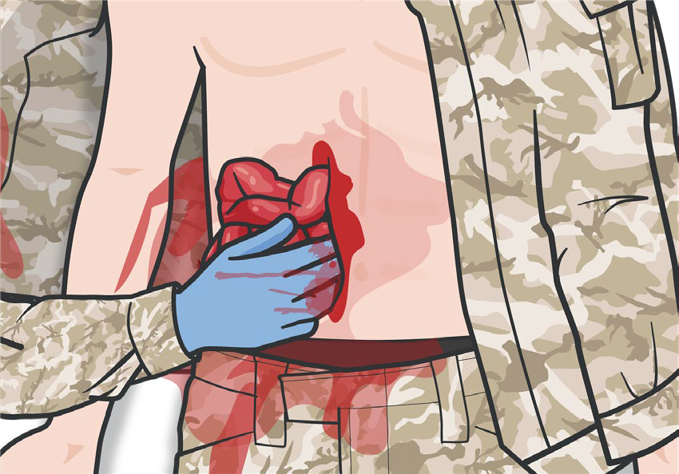
OPEN ABDOMINAL WOUND MANAGEMENT
Module 17: Wound Management
CAUTION:
DO NOT attempt if there is evidence of ruptured bowel (gastric/intestinal fluid or stool leakage) or active bleeding
DO NOT FORCE
contents into abdomen or actively bleeding viscera or remove foreign objects
MANAGEMENT STEPS:
1
PLACE the casualty in the supine position, with knees flexed
Expose the wound inspecting for DCAP- BLS and TRD-P
3a
Rinse the wound with clean (and warm, if possible) fluid
Apply CoTCCC- recommended hemostatic
4
Consider a single brief attempt (<60 sec) to reduce/replace eviscerated
abdominal contents
2
3b
dressing or hemostatic agent to any uncontrolled bleeding
P A
W
S
Notes:
Open abdominal wounds merit more in-depth discussion, especially in light of the recent TCCC Guideline updates from 2021, which provide more detailed recommendations for the management of this wound pattern.
These wounds have several potentially serious complications including:
Increased risk of hypothermia – insensible heat losses from the evaporative process from the open abdomen
Fluid loss – dehydration from the evaporative processes
Internal hemorrhage – significant volume of pooled blood or ongoing hemorrhage may not be visible at the surface
Infections – both from the nature of the injury and from potential bowel perforation
Management of an open abdominal wound involves several steps:
Irrigate with clean, preferably sterile, fluid to reduce gross contamination
Control hemorrhage, if applicable, to include using hemostatic agents
If bowels are exposed, a single (ONE-time) attempt to reduce the evisceration without forcing contents back into the abdomen can be made
If possible and not prevented by protruding bowel, reapproximate the skin and secure it with staples or sutures, or with an adhesive like tape or chest seals
Stabilize impaled objects
Cover exposed bowel with moist, sterile abdominal dressings, if available (and keep wet)
Cover dressing with water-impermeable non-adhesive material (preferably transparent like a plastic wrapper, IV bag, clear food wrap, etc.), and then secure it in place with tape or some other adhesive material
Prevent hypothermia
If reduction attempt is successful, re-approximate the skin using available material, preferably an adhesive dressing (chest seal, for example) or with staples, sutures or a wound closure device
Stabilize any protruding objects
Cover exposed bowel with moist, sterile abdominal dressings, if available (and keep wet)
Cover dressing with water-impermeable non-adhesive material (preferably transparent like a plastic wrapper, IV bag, clear food wrap, etc.), and then secure it in place with tape or some other adhesive material. DO NOT apply pressure on the wound or further expose internal organs. Prevent hypothermia.
Secure the impermeable dressing to the patient using adhesive bandage (examples: medical tape, chest seal, etc.).
Assess and treat the casualty for shock and continue to reassess periodically.
Prevent hypothermia as exposed abdominal contents will result in more rapid heat loss.
Document all findings and treatments on a DD Form 1380 TCCC Casualty Card and attach it to the casualty.
There are a few additional caveats that should be kept in mind, as well. It is okay to give oral antibiotics, as the absorptive/digestive functions of the bowel have not been compromised, so advise the casualty to take the antibiotic from their Combat Wound Medication Pack. These casualties are at high risk for shock, and should continuously be reassessed for the signs and symptoms of shock. If the casualty presents late (the injury occurred quite a while earlier), a single reduction attempt is still appropriate, but the odds of success are lower. If potential evacuation to surgical care is uncertain, you may decide not to attempt a reduction.
It is also important to note that closed abdominal injuries from blast exposure can be a significant problem. In some studies, they appear to be as frequent as pulmonary blast injury. Complications include infections from ruptured bowel, internal bleeding, and solid organ damage. Presenting signs are often unexplained nausea and vomiting and/or abdominal pain. There is nothing specific that can be done in the field to diagnose or manage these complications, but awareness of their potential presence may save the casualty’s life, if they are communicated with the medical team receiving the casualty.
NOTE:
If an adhesive bandage isn’t available, loosely cover the dressing with cravats and tie them on the side of the casualty opposite that of the dressing ties (if present).
Use multiple dressings and cravats, if needed, to cover a large wound, ensuring tails of additional dressings are not tied over each other.
The most important concern in the initial management of abdominal injuries is shock.
CAUTION:
Shock may be present initially or may develop later.

Slide 8



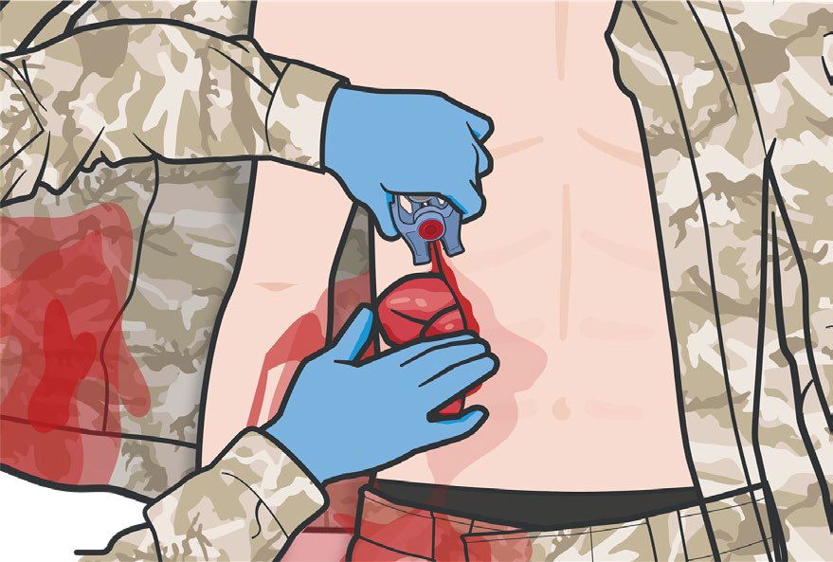
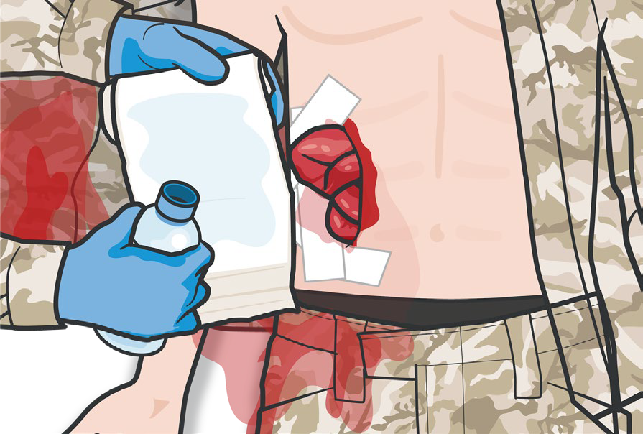
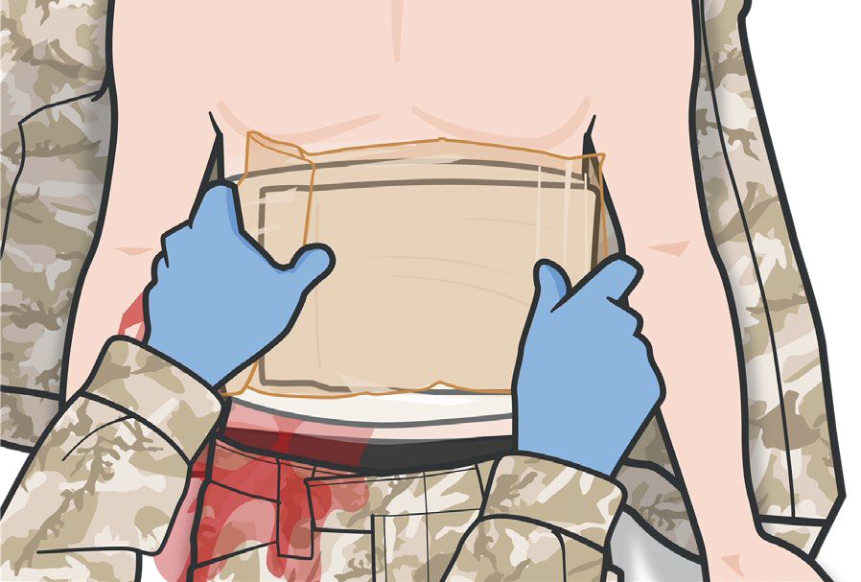

OPEN ABDOMINAL WOUND
Module 17: Wound Management
MANAGEMENT cont.
CAUTION:
Protruding abdominal organs should be kept moist
Cover the entire mass of protruding organs or area of the wound.
Using the sterile side of the dressing, or other clean, damp material, gather or keep any protruding organs near the wound and cover the wound.
NOTE: Do not touch exposed organs with bare hands.
If using a dressing with tails, tie loosely and do not tie directly over the wound.
MANAGEMENT STEPS:
5
If reduction attempt is successful, re- approximate the skin
7
Cover exposed bowel with moist, sterile abdominal dressings
9
Secure the impermeable dressing to patient using adhesive bandage
6
Stabilize any protruding objects
8
Cover the dressed, eviscerated organs with water impermeable non- adhesive material
P A
W
S
Level of Evidence: C-LD

Slide 9



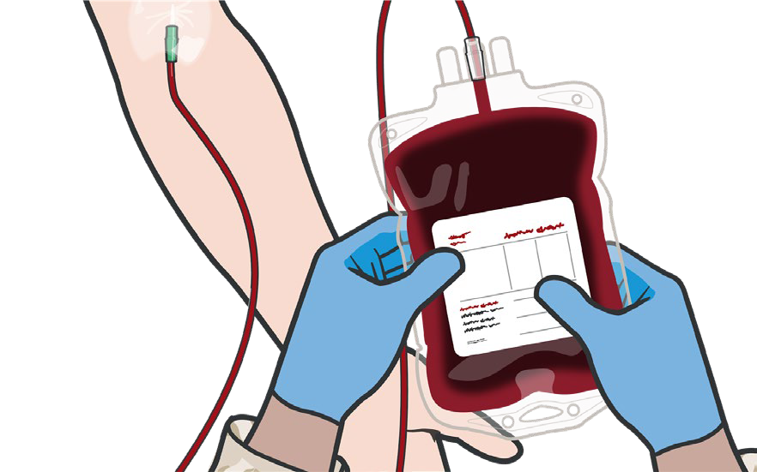
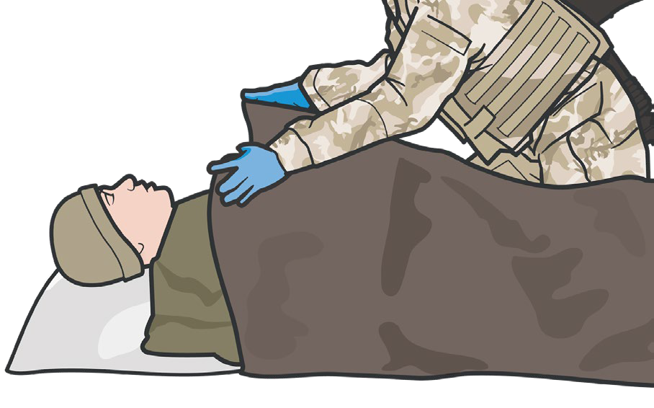
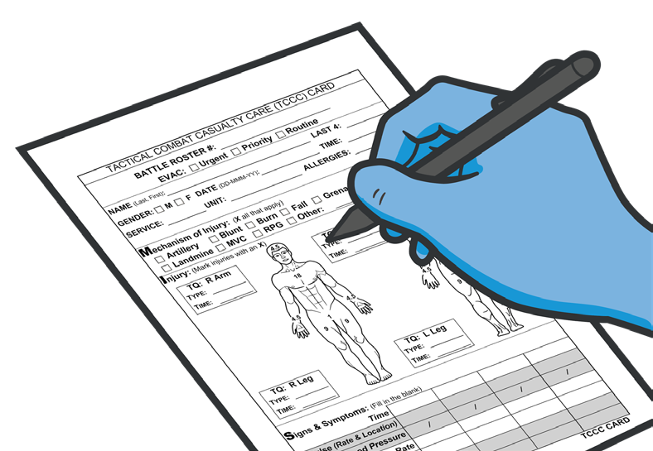
OPEN ABDOMINAL WOUND MANAGEMENT cont.
Module 17: Wound Management
CAUTION:
The most important concern in the initial management of abdominal injuries is shock
Shock may be present initially or may develop later
MANAGEMENT STEPS:
10
Assess and treat the casualty for shock and continue to reassess periodically
11
Prevent hypothermia as exposed abdominal contents will result in more rapid heat loss
12
Document all findings and treatments on a DD Form 1380 TCCC
Casualty Card and attach it to the casualty
P A
W
S
Level of Evidence: C-LD

Slide 10

Module 17: Wound Management
MANAGING AN OPEN ABDOMINAL WOUND
Video can be found on deployedmedicine.com
Notes:
The following video will demonstrate the management of an open abdominal wound in a Tactical Field Care setting.

Slide 11



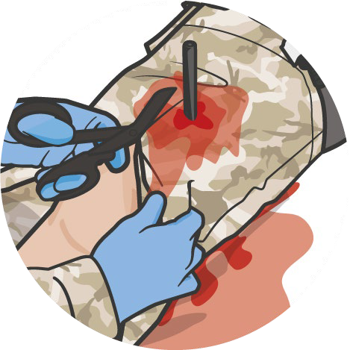
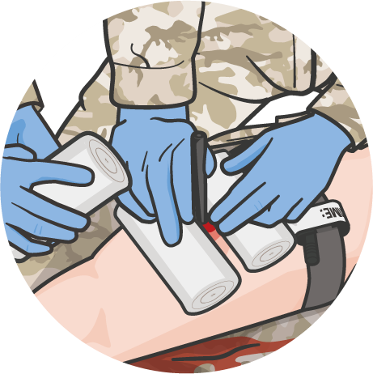
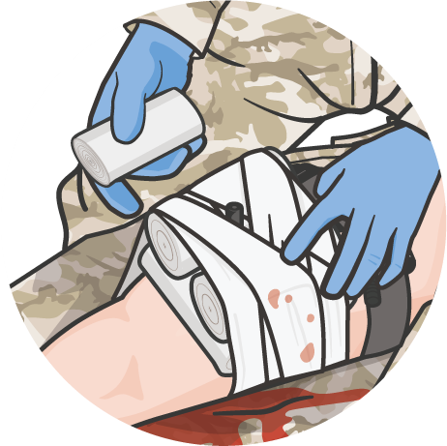

WOUND MANAGEMENT WITH IMPALED OBJECTS
Module 17: Wound Management
DO NOT remove impaled objects
CONSIDERATIONS:
Impaled object may be stopping internal bleeding
Internal structures may be damaged by removal of impaled object
MANAGEMENT STEPS:
Expose the object
Control bleeding
Stabilize the object
Build up materials
around object
Use EXTREME CAUTION to
prevent movement of the impaled object during casualty movement
Secure materials
& object
Splint, if indicated
Level of Evidence: C-LD
P A W S
Notes:
Impaled objects present some unique problems in wound management. In many cases, the removal of an impaled object can cause additional internal (and external) hemorrhage, particularly if it is not located on an extremity.²⁰ The structures at the base of the impaled object may be compromised, depending on the shape of the object, when it is removed. So, taking an x-ray or other image to determine the risks of removal and then removing it in a more controlled environment is preferred.²¹ This is definitely true in the tactical environment, where impaled objects should be left in place and the casualty should be evacuated to a facility that has the capability to deal with impalements.
Prior to stabilizing a protruding object, the site needs to be exposed and any bleeding needs to be controlled. The exposure usually just requires that the clothing around the site be cut free or removed. If parts are pinned in by the object, then cut the rest of the clothing free.²²
For bleeding control, direct pressure can be applied at the base of the impaled object, and hemostatic dressings and pressure bandages can be applied, if applicable. However, it is difficult to achieve and maintain good direct pressure with some impalements, and early consideration for tourniquet application should be considered if bleeding persists. Also, check the pulse distal to the impalement if found on an extremity to know whether vascular compromise is probable, as this information will facilitate proper treatment once the casualty is evacuated.
Stabilization is generally best done with at least one assistant. While one person keeps the object in position and stable, the other can begin to work around the base of the object. Using locally available bulky materials and starting at the wound edges around the impaled object, these materials can be built up to form a base. Do not exert pressure on the tissues around the object building the base, except to control bleeding, particularly if it is located in the eye. Examples of materials include medical supplies like gauze, rolls of kerlix, pads or dressings, or non-medical supplies like clean, dry cloth, or flexible padding materials.
Once the object has been encircled and a base of materials appropriate for the length of the object has been built, the base needs to be secured. This can be done with adhesive seals, like tape or by using cloth strips, cravats, or bandages tied in place to hold the base materials against the impaled object.
If the impalement is on an extremity, treat it like a fracture and stabilize the joint above and below the location of the object with splints. This will provide added protection against unintended movement. Reassess distal pulses after dressing and splinting on an extremity.
Regardless of the location, reassess to ensure bleeding has been controlled, the casualty is not in shock and the object is secured.
Although there may be a unique situation when an impaled object prevents casualty movement or evacuation, those situations are unusual and, as a rule, the object should not be shortened for convenience of transport. Only if it will prevent evacuation should modification of a portion of the protruding object be considered, and then with extreme caution to prevent movement of the impaled part of the object during the modification process.²³
The evidence supporting the treatment of impaled objects is mostly meta-analysis of observational studies, lab evaluations, and case studies.

Slide 12
Module 17: Wound Management
MANAGING AN IMPALED OBJECT
Video can be found on deployedmedicine.com
Notes:
The following video will demonstrate the management of an impaled object in a Tactical Field Care setting.

Slide 13



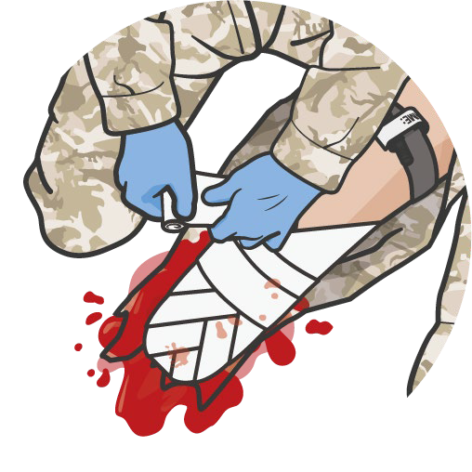

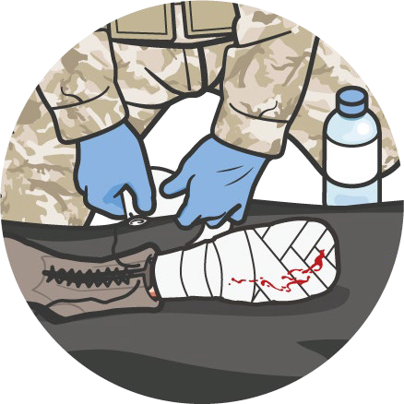


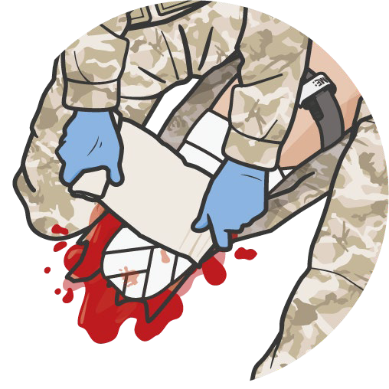
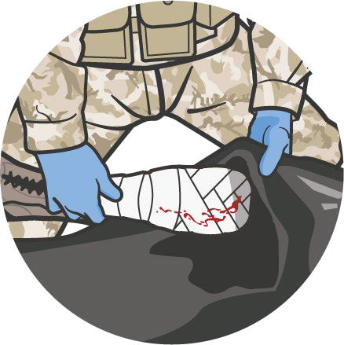
WOUND MANAGEMENT OF AMPUTATIONS
Module 17: Wound Management
Management of Amputated Wound Stumps:
CONFIRM bleeding controlled (tourniquet, not direct pressure)
WRAP open areas with sterile gauze or clean, dry cloth
SECURE dressing with bandages or cravats, extending 4 inches above the amputation
Do NOT cover any tourniquets
Care of the Amputated Body Part:
WRAP loosely with saline- moistened gauze
PLACE in plastic bag or wrap in a cravat
TRANSPORT in container with ice, preferably with casualty
Do NOT place body part directly on ice, submerse in water, or cool with dry ice
Do NOT delay evacuation to locate or care for amputated body part
CAUTION:
Protruding sharp bones may injure responders
Level of Evidence: C-LD
P A W S
Notes:
Caring for the wounds associated with an amputation is different than other minor wounds or other dressings.
The control of bleeding is not accomplished through direct pressure at the stump, but through the use of the tourniquet applied above the amputation; so, any persistent bleeding that might be present must be resolved by further tightening of the tourniquet or application of a second tourniquet proximal to the first. Prior to dressing an amputation wound, the hemorrhage must be controlled.²⁴
As the amputation is often very irregular, it may take a significant amount of gauze or dressing to wrap the casualty’s stump. It is also important to exercise caution in applying the gauze, as it is not uncommon for sharp bones to protrude and potentially injure the responders. Once the entire area is covered in gauze or dressings, bandages or cravats can be applied to keep everything in place, extending up 4 inches proximal to the edges of the stump. Be sure NOT to cover the tourniquets, though, in case they need to be accessed quickly.
In addition to dressing the stump, you must also take care of the amputated body part. Wrap the amputated body part loosely with moistened gauze. If possible, place it in a plastic bag; if not, wrap it with cravats to cover all of the gauze. Then place the bag, or the cravat-covered body part, in a container with ice, if available. Keep in mind that you do NOT want to have the body part directly in contact with the ice or submersed in water. And once cooled, maintain cooling throughout transport (avoid allowing the body part to warm because of a lack of ice or refrigeration).^{25, 26}
The body part should accompany the casualty for potential reimplantation or use for skin grafting. But an evacuation should not be delayed to locate or care for an amputated body part.
The evidence supporting the wound management of amputations is mostly meta-analysis of observational studies, lab evaluations, and case studies.

Slide 14
Module 17: Wound Management
AMPUTATION BANDAGING
Video can be found on deployedmedicine.com
Notes:
The following video will demonstrate how to bandage an amputation stump and care for the amputated body part in a Tactical Field Care setting.

Slide 15

Module 17: Wound Management
EVIDENCE SUPPORTING WOUND MANAGEMENT STRATEGIES
Subject Category | Study Types | Level of Evidence
Wound Management Principles | Meta-analysis of observational studies, lab evaluations and case studies. | C-LD
Open Abdominal Wound Management | Meta-analysis of observational studies, lab evaluations and case studies | C-LD
Wound Management with Impaled Objects | Meta-analysis of observational studies, lab evaluations and case studies | C-LD
Wound Management of Amputations | Meta-analysis of observational studies, lab evaluations and case studies | C-LD
Notes:
The evidence supporting wound management strategies in Tactical Field Care is varied, ranging from clear positive effects based on retrospective observational reviews to a consensus of subject matter expert opinions.
General wound management principles in Tactical Field Care are supported by several observational reviews, but also derive implied strength from many wound management studies performed outside of the TFC environment, which bolster the evidence supporting those strategies.
The management of open abdominal wounds is the subject of a recently drafted, yet-to-be-published, review article highlighting the studies and evidence behind current recommendations. In general, the evidence is moderately supportive of the guidelines and strategy, with some sections having a higher level of evidence.
Strategies for managing impaled objects rely more heavily on case reports and observational studies, but overall, still provide a low to moderate level of evidence to support the current recommendations.
Amputation wound care has the least supporting evidence and draws significantly from subject matter consensus opinions. That said, there are still positive effects noted in observational studies and low evidence supporting current management guidelines.

Slide 16

Module 17: Wound Management
ASSESSING THE EVIDENCE FOR GUIDELINES
Level of Evidence | AHA Recommendation System Terminology Explanation | Why the AHA Classification System?
A | Evidence from multiple randomized clinical trials (RCT) with concordant results or from HIGH-QUALITY meta-analyses. | The level of evidence recommendations allow readers to quickly glean information on the strength, certainty, and quality of evidence supporting each recommendation. A recommendation with Level of Evidence (LOE) C does not imply that the recommendation is weak. Although, RCTs are unavailable, there may be a very clear clinical consensus that a particular test or therapy is useful or effective.
B-R | Evidence from moderate-quality trials, or a meta-analysis of moderate quality (RCT) followed by an R to denote RANDOMIZED studies
B-NR | Evidence from moderate-quality trials, or a meta-analysis of moderate quality followed by NR to denote NON-RANDOMIZED studies
C-LD | There is no convincing evidence and is followed by LD to indicate LIMITED DATA
C-EO | There is no convincing evidence and is followed by EO if the consensus is based on EXPERT OPINION, case studies or standards of care.
Notes:
Evidence-based recommendations and guidance are the result of a careful review of studies and discussion by a panel of subject matter experts. For TCCC, the subject matter expert panels include both Committee on TCCC members and select invited subject matter experts from within both the military and civilian community, based on the specific interest area.
Why the AHA Classification System?
The level of evidence classification combines an objective description of the existence and the types of studies supporting the recommendation and expert consensus, according to 1 of the following 3 categories:³⁸
Level of evidence A: recommendation based on evidence from multiple randomized trials or meta-analyses
Level of evidence B: recommendation based on evidence from a single randomized trial or nonrandomized studies
Level of evidence C: recommendation based on expert opinion, case studies, or standards of care.
The level of evidence recommendations allows readers to quickly glean information on the strength, certainty, and quality of evidence supporting each recommendation. The Level of Evidence (LOE) denotes the confidence in or certainty of the evidence supporting the recommendation, based on the type, size, quality, and consistency of pertinent research findings.³⁹
A recommendation with level of evidence C does not imply that the recommendation is weak. Many important clinical questions addressed in guidelines do not lend themselves to clinical trials. Although, Randomized Clinical Trials are unavailable, there may be a very clear clinical consensus that a particular test or therapy is useful or effective.

Slide 17

SKILL STATION
Module 17: Wound Management
Wound Management
Open Abdominal Wound Management Impaled Object Wound Management Amputation Wound Management

Slide 18
SUMMARY
Module 17: Wound Management
Knowledge Topics
General wound management principles Open abdominal wound dressings Impaled object wound management
Amputation stump and amputated body part care
Evidence supporting wound management recommendations
Skills and Abilities
Open abdominal wound dressings application
Impaled object wound dressing application
Amputation stump and amputated body part care dressing application
Notes:
This module highlighted the wound management principles you should know for Tactical Field Care.
We discussed general wound management principles, and then went into more detail on open abdominal wounds, impaled objects, and dressing amputations. Additionally, we covered the evidence for the strategies behind wound management in the TFC setting.
Also, you demonstrated the application of open abdominal, impalement, and amputation wound dressings in the skills station.

Slide 19

CHECK ON LEARNING
Module 17: Wound Management
After applying pressure to stop bleeding, if necessary, what is the next step in treating a minor wound?
Name three of the four complications of open abdominal wounds
If an impaled object is on an extremity, what do you need to do in addition to stabilizing the object?
How do you care for an amputated body part?
Notes:
To close out this module, check your learning with the questions below (answers under the image).
Answers
After applying pressure to stop bleeding, if necessary, what is the next step in treating a minor wound?
Next, irrigate and clean wounds with either sterile water, if it is available, or even clean water if your supplies are limited or you have no access to sterile water.
Name three of the four complications of open abdominal wounds.
Increased risk of hypothermia – insensible heat losses from the evaporative process from the open abdomen
Fluid loss – dehydration from the evaporative processes
Internal hemorrhage – significant volume of pooled blood or ongoing hemorrhage may not be visible at the surface
Infections – both from the nature of the injury and from potential bowel perforation
If an impaled object is on an extremity, what do you need to do in addition to stabilizing the object?
If the impalement is on an extremity, treat it like a fracture and stabilize the joint above and below the location of the object with splints.
How do you care for an amputated body part?
Wrap the amputated body part loosely with moistened gauze. If possible, place it in a plastic bag; if not, wrap it with cravats to cover all of the gauze. Then place the bag, or the cravat-covered body part, in a container with ice, if available.

Slide 20




Module 17: Wound Management
ANY QUESTIONS?

Slide 21
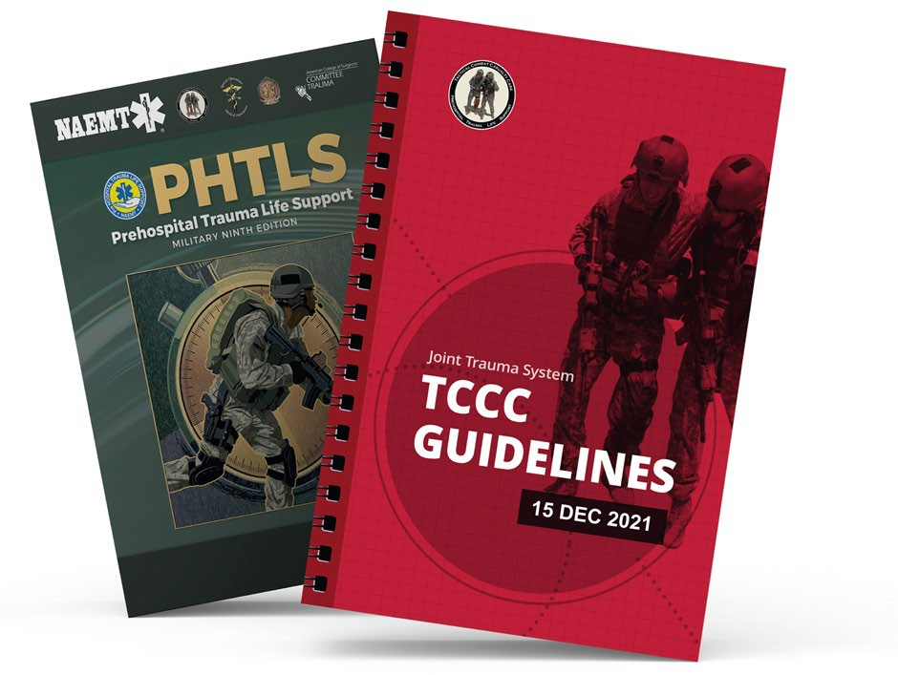
REFERENCES
Module 17: Wound Management
TCCC: Guidelines
by JTS/CoTCCC
These guidelines, updated regularly, are the result of decisions made by CoTCCC in exploring evidence-based research on best practices.
PHTLS: Military Edition, Chapter 25
by NAEMT
Prehospital Trauma Life Support (PHTLS), Military Edition, teaches and reinforces the principles of rapidly assessing a trauma patient using an orderly approach.
Notes:
¹ Tactical Combat Casualty Care Guidelines (15 December 2021), Basic Management Plan for Tactical Field Care, Paragraphs 12 and 13.
² Tactical Combat Casualty Care Guidelines (15 December 2021), Basic Management Plan for Tactical Field Care, Paragraph 6.a.
³ Tactical Combat Casualty Care Guidelines (15 December 2021), Basic Management Plan for Tactical Field Care, Paragraph 6.a.
⁴ Tactical Combat Casualty Care Guidelines (15 December 2021), Basic Management Plan for Tactical Field Care, Paragraph 8.
⁵ Tactical Combat Casualty Care Guidelines (15 December 2021), Basic Management Plan for Tactical Field Care, Paragraph 5.b.
⁶ Tactical Combat Casualty Care Quick Reference Guide, 1st Edition, 2017, p. 13.
⁷ Soldier’s Manual and Training Guide MOS 68W, Health Care Specialist Skill Levels 1, 2, and 3.
⁸ Hospenthal DR, Murray CK, Andersen RC, et al. Guidelines for the prevention of infections associated with combat-related injuries: 2011 update: endorsed by the Infectious Diseases Society of America and the Surgical Infection Society. J Trauma. 2011 Aug;71(2 Suppl 2):S210-234.
⁹ Tactical Combat Casualty Care Guidelines (15 December 2021), Basic Management Plan for Tactical Field Care, Paragraph 12.b.
¹⁰ Rignault, D. Recent progress in surgery for the victims of disaster, terrorism, and war—Introduction. World Journal of Surgery. 1992 volume 16, pp 885–887.
¹¹ Coccolini F, et al. The open abdomen in trauma and non-trauma patients: WSES guidelines. World Journal of Emergency Surgery (2018) 13:7.
¹² Petersen K, Riddle MS, Danko JR, et al. Trauma-related infections in battlefield casualties from Iraq. Ann Surg. 2007;245:803– 811.
¹³ Olorundare, EO et al. Abdominal Injuries in communal Crises: The Jos Experience. J Emerg Trauma Shock. 2016 Jan-Mar; 9(1): 3–9.
¹⁴ Riesberg J, Moore M, et al. The Management of Abdominal Evisceration in Tactical Combat Casualty Care; TCCC Guideline Change - October 2020, preprint publication.
¹⁵ Tactical Combat Casualty Care Guidelines (15 December 2021), Basic Management Plan for Tactical Field Care, Paragraph 12.b.
¹⁶ Tactical Combat Casualty Care Guidelines (15 December 2021), Basic Management Plan for Tactical Field Care, Paragraph 12.b.
¹⁷ Murray CK, Hospenthal D. Antibiotics Use and Selection at the Point of Injury in Tactical Combat Casualty Care. JSOM. 2005; 5(3):56-61.
¹⁸ Tactical Combat Casualty Care Guidelines (15 December 2021), Basic Management Plan for Tactical Field Care, Paragraph 12.b.
¹⁹ Prehospital Trauma Life Support, 9th Edition, Military Edition. Chapter 25, p 934.
²⁰ Kelly IP, et al. The management of impalement injury. Injury. April 1995, pp 191-193.
²¹ Horowitz MD. Impalement Injuries. J Trauma. 1985 Sep: 25(9), pp 914-6.
²² Army TC 4-02.1, First Aid, Chapter 18.
²³ Cassone M, Sagalyn E, Dickinson E. Far from care: EMS in the wilderness requires special considerations. J Emergency Medical Services. 2012 Apr: 37(4), pp 38-40, 42-7.
²⁴ Rush RM, Arrington ED, & Hsu JR. Management of complex extremity injuries: Tourniquets, compartment syndrome detection, fasciotomy, and amputation care. Surgical Clinics of North America (2012). 92(4), 987-1007.
²⁵ Tactical Combat Casualty Care Combat Medic/Corpsman Course, Module 17 Skill Instruction.
²⁶ Meenach, Dean. “How to manage traumatic amputations and uncontrolled bleeding.” EMS In Focus. EMS1.com, 30 Apr. 2014. Web. 17 Oct 2021.
²⁷ Cassone M, Sagalyn E, Dickinson E. Far from care: EMS in the wilderness requires special considerations. J Emergency Medical Services. 2012 Apr: 37(4), pp 38-40, 42-7
²⁸ Coccolini F, et al. The open abdomen in trauma and non-trauma patients: WSES guidelines. World Journal of Emergency Surgery (2018) 13:7 C-LD
²⁹ Horowitz MD. Impalement Injuries. J Trauma. 1985 Sep: 25(9), pp 914-6 C-LD
³⁰ Hospenthal DR, Murray CK, Andersen RC, et al. Guidelines for the prevention of infections associated with combat-related injuries: 2011 update: endorsed by the Infectious Diseases Society of America and the Surgical Infection Society. J Trauma. 2011 Aug;71(2 Suppl 2):S210-23 C-LD
³¹ Kelly IP, et al. The management of impalement injury. Injury. April 1995, pp 191-193 C-LD
³² Meenach, Dean. “How to manage traumatic amputations and uncontrolled bleeding.” EMS In Focus. EMS1.com, 30 Apr. 2014. Web. 17 Oct 2021
³³ Murray CK, Hospenthal D. Antibiotics Use and Selection at the Point of Injury in Tactical Combat Casualty Care. JSOM. 2005; 5(3):56-61 C-LD
³⁴ Olorundare, EO et al. Abdominal Injuries in communal Crises: The Jos Experience. J Emerg Trauma Shock. 2016 Jan-Mar; 9(1): 3–9 B-R
³⁵ Petersen K, Riddle MS, Danko JR, et al. Trauma-related infections in battlefield casualties from Iraq. Ann Surg. 2007;245:803– 811 C-LD
³⁶ Rignault, D. Recent progress in surgery for the victims of disaster, terrorism, and war—Introduction. World Journal of Surgery. 1992 volume 16, pp 885–887
³⁷ Rush RM, Arrington ED, & Hsu JR. Management of complex extremity injuries: Tourniquets, compartment syndrome detection, fasciotomy, and amputation care. Surgical Clinics of North America (2012). 92(4), 987-1007 C-LD
³⁸ Tricoci P, Allen JM, Kramer JM, Califf RM, Smith Jr SC. Scientific Evidence Underlying the ACC/AHA Clinical Practice Guidelines. American Medical Association. 2009 Feb; Vol 301, No. 8.
³⁹ Halparin, JL. Further Evolution of the ACC/AHA Clinical Practice Guideline Recommendation Classification System. American College of Cardiology Foundation and the American Heart Association. 2016 Apr; 133:1426-1428.

